Slide 1
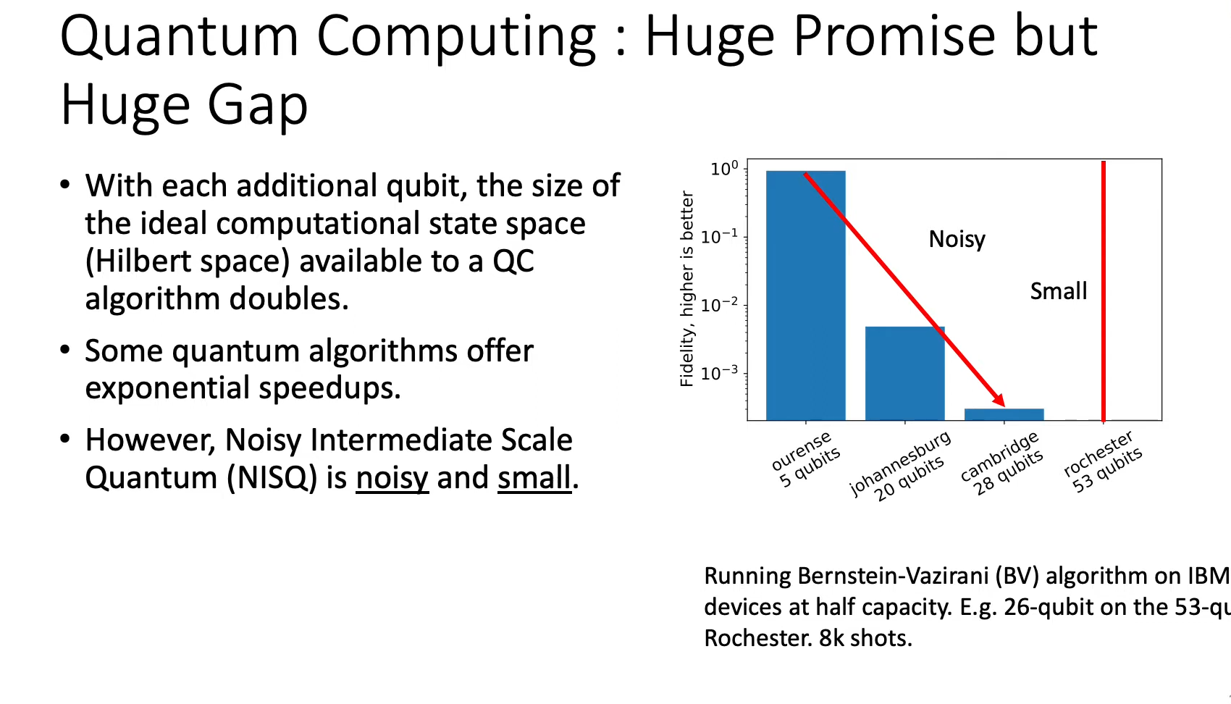

Slide 2

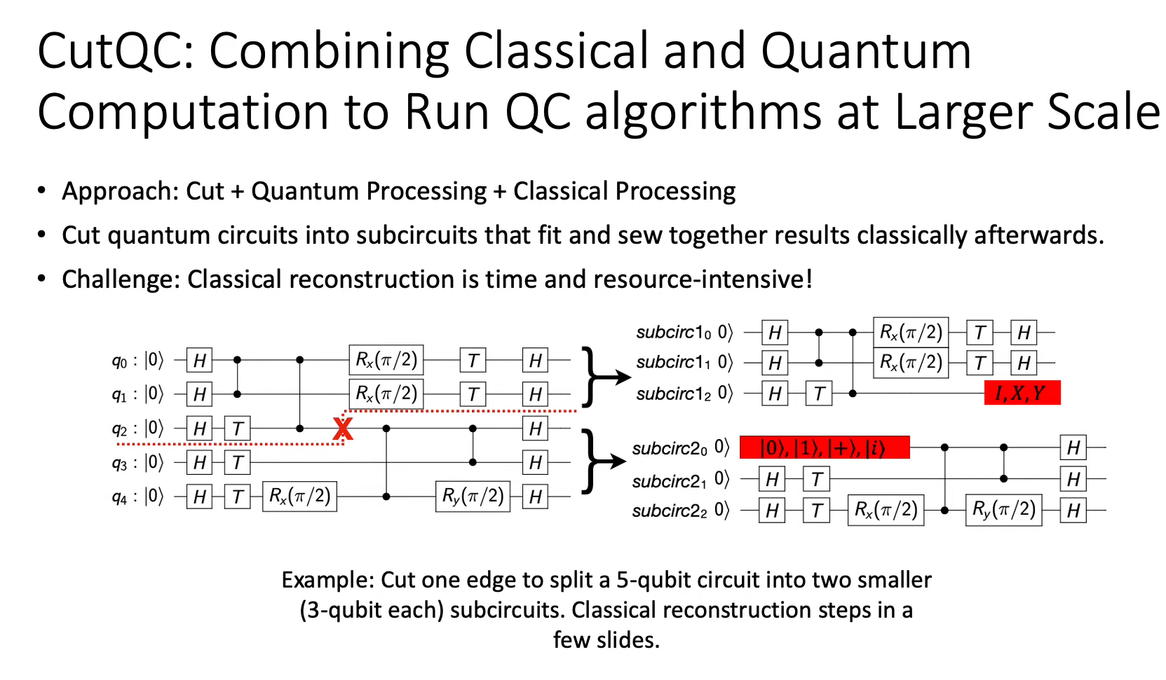

Slide 3
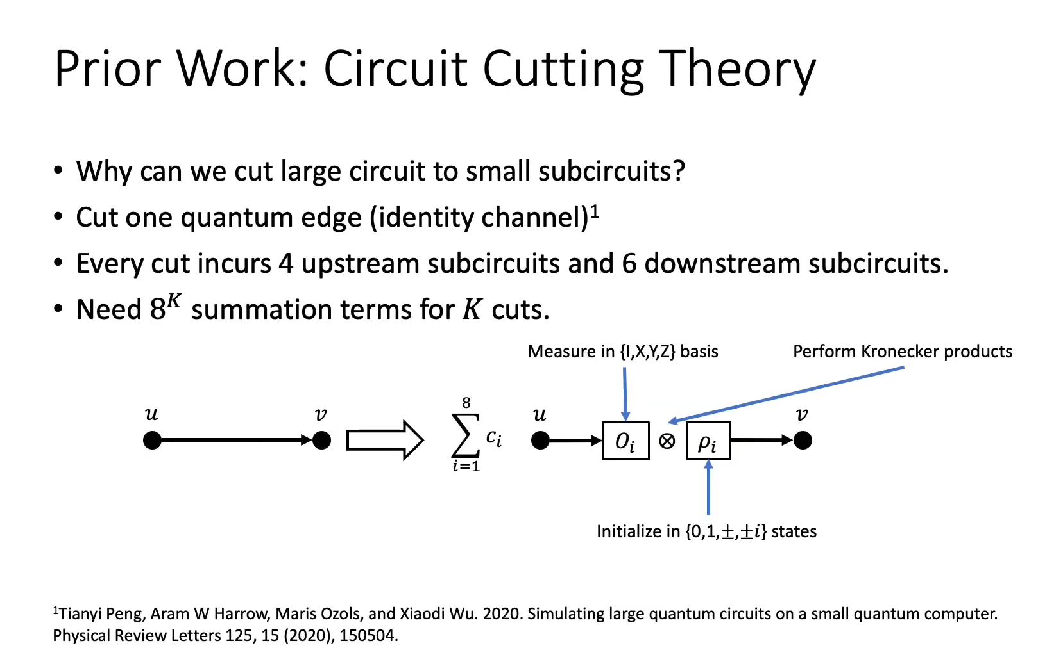

Slide 4
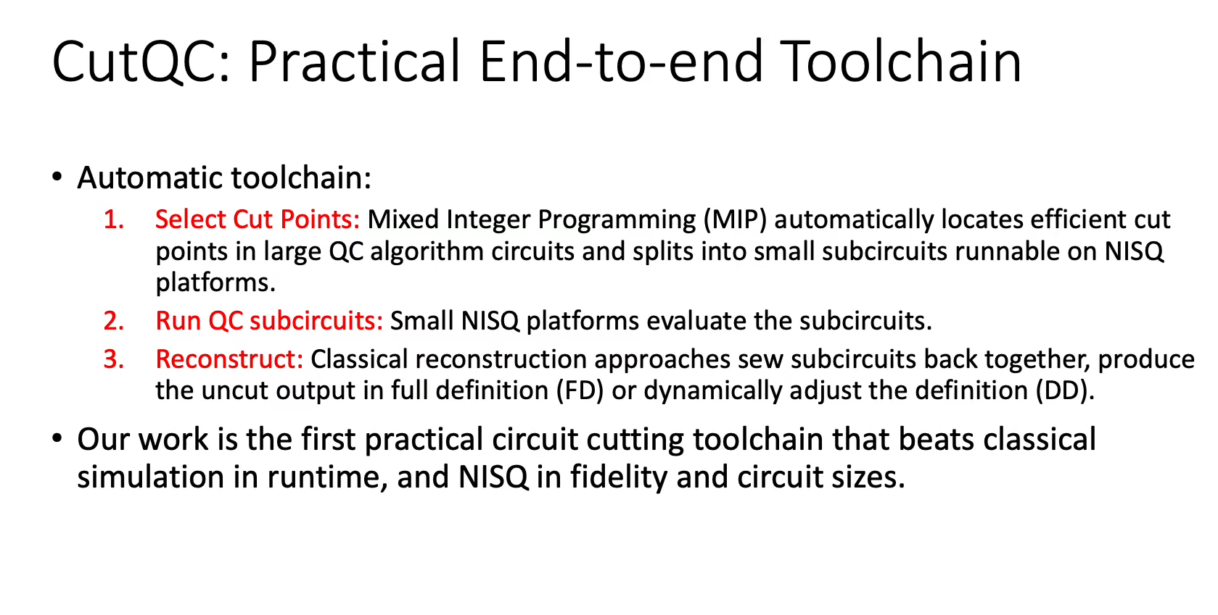

Slide 5
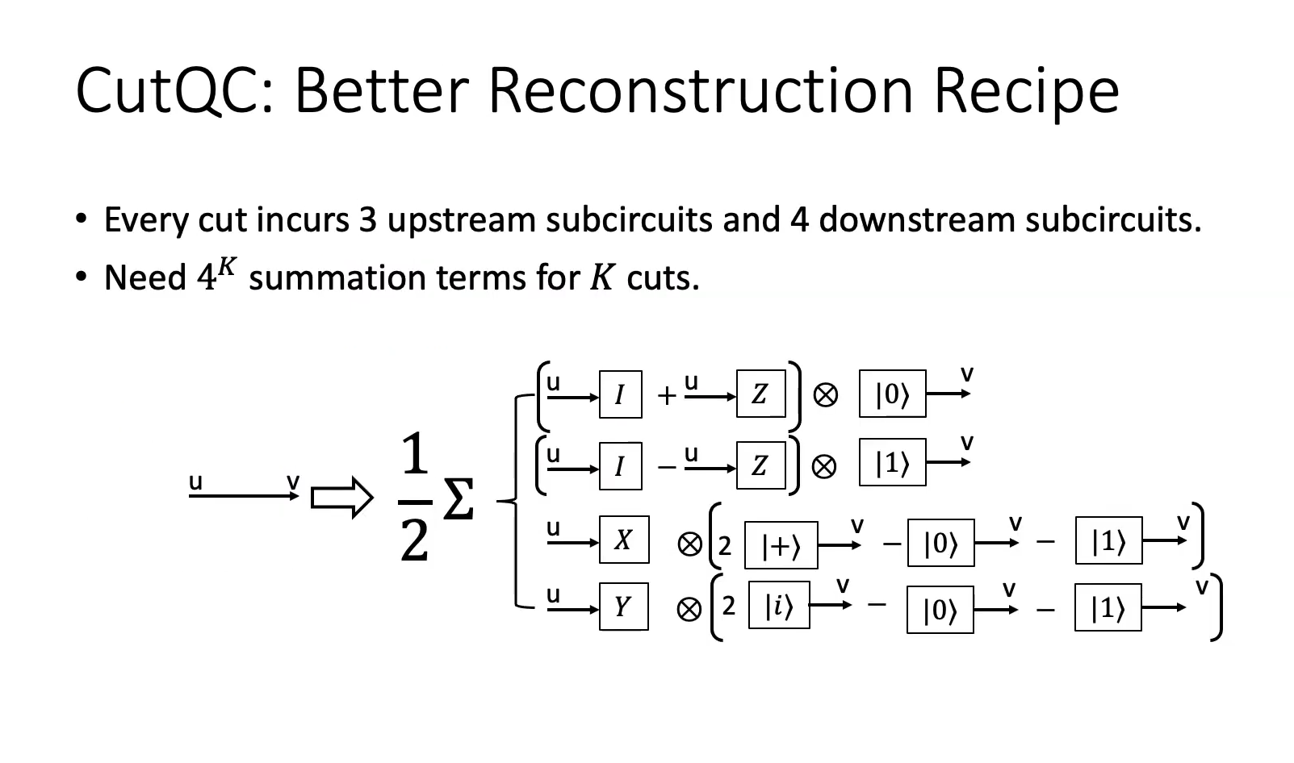

Slide 6
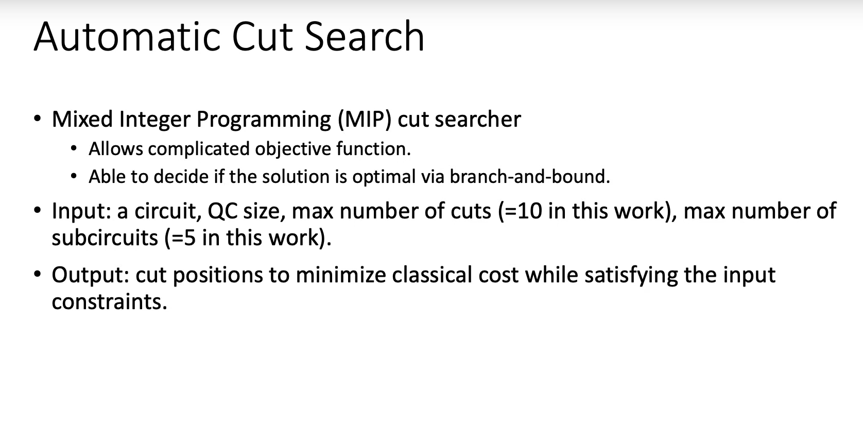

Slide 7
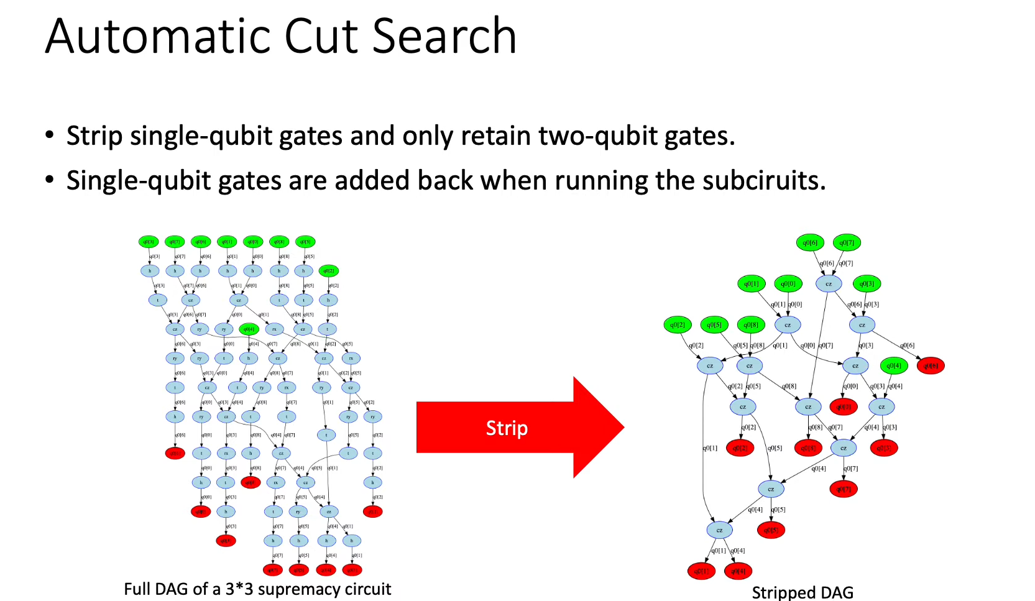

Slide 8
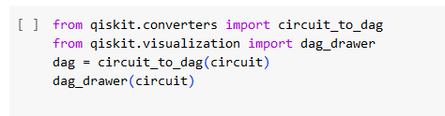
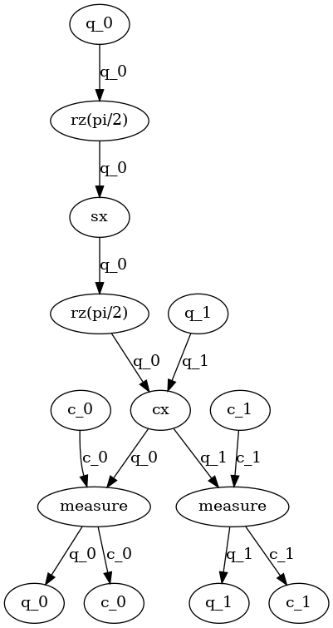
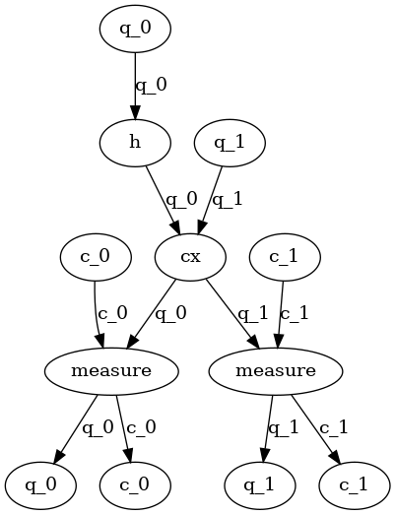
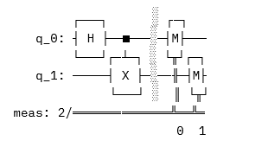

Slide 9
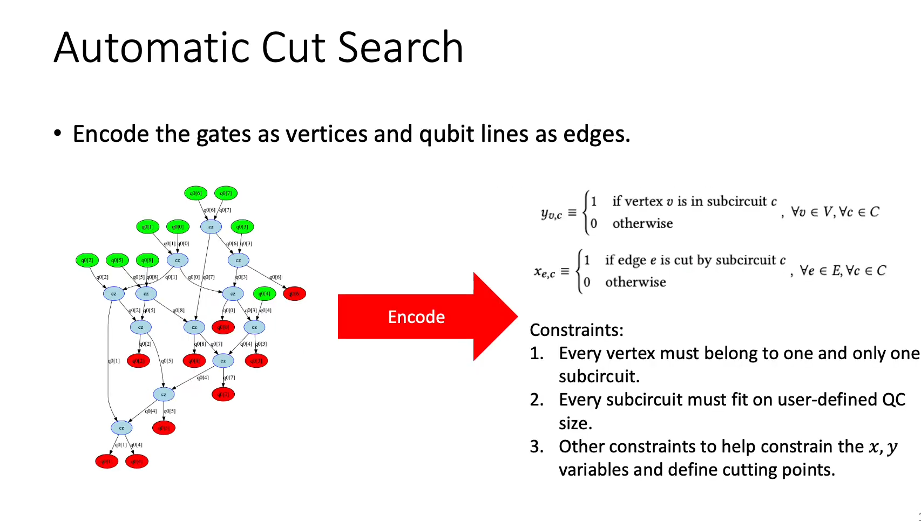

Slide 10
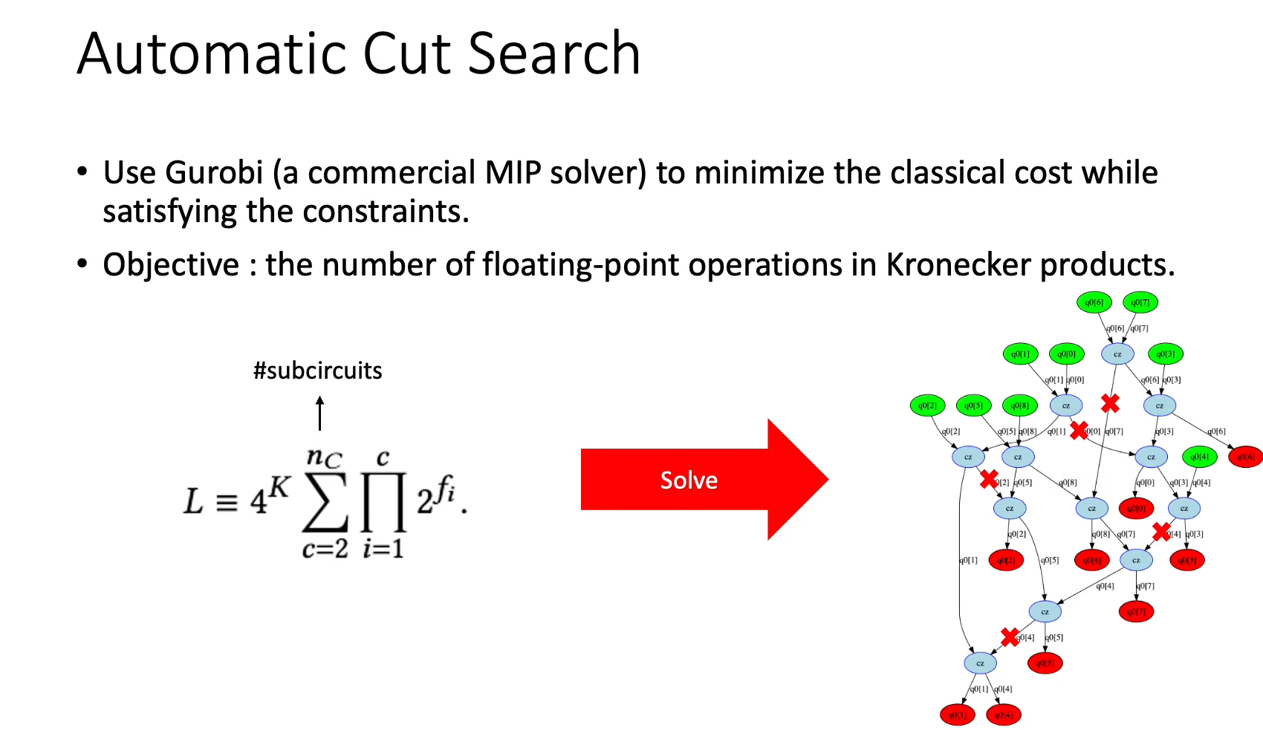

Slide 11
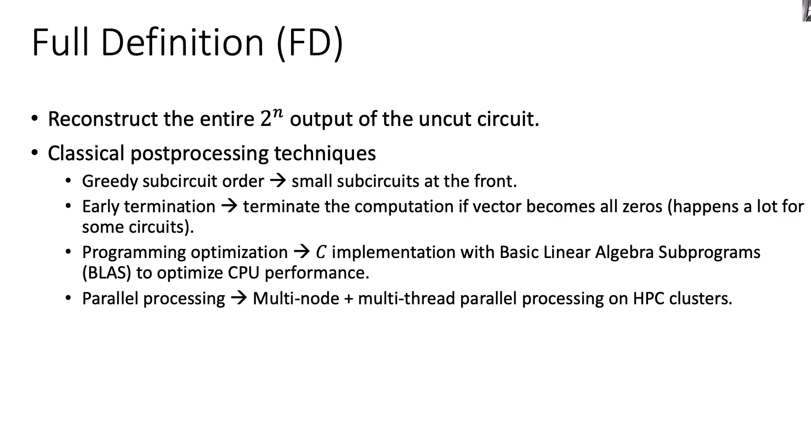

Slide 12
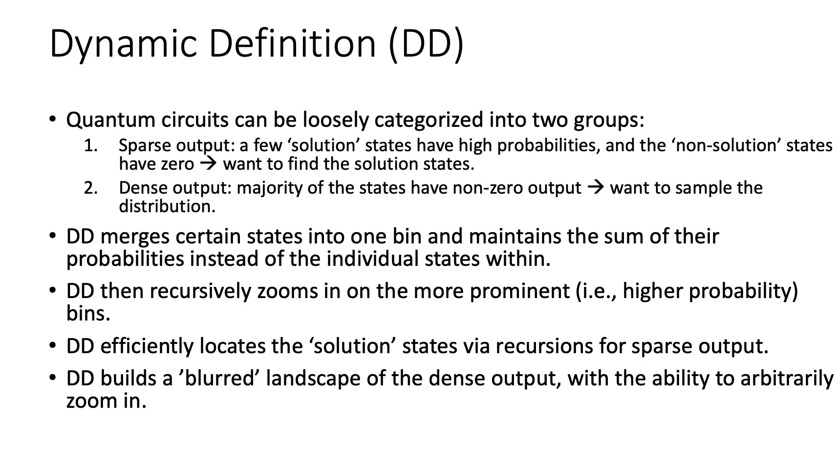

Slide 13
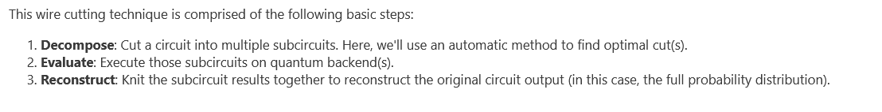
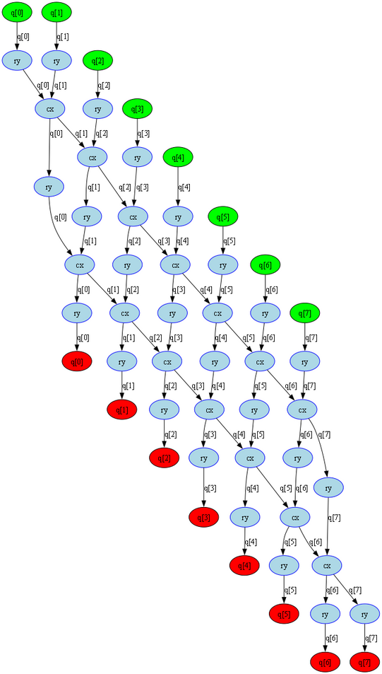
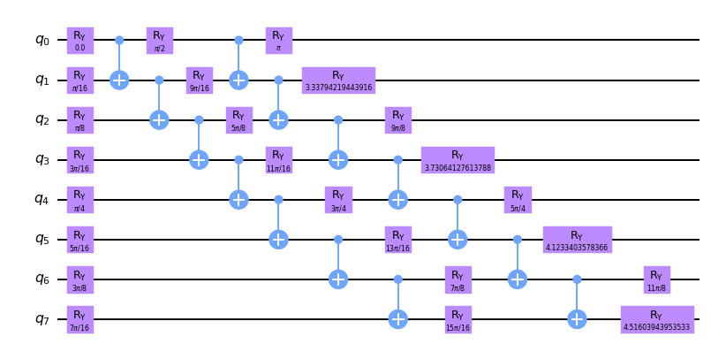


Slide 14
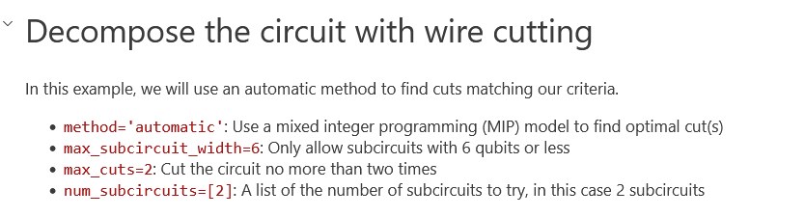
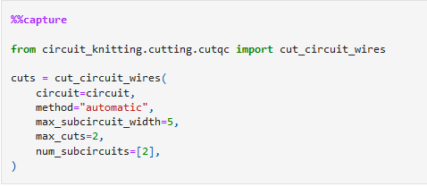
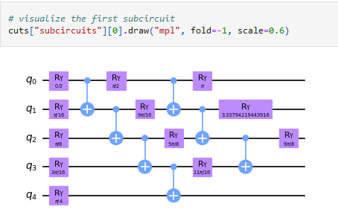
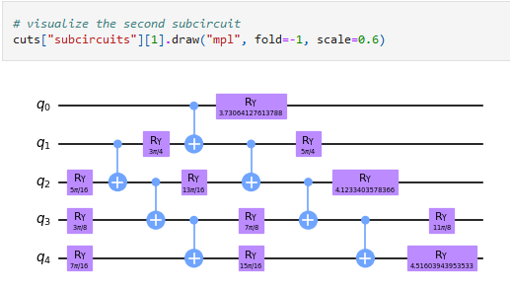

Slide 15
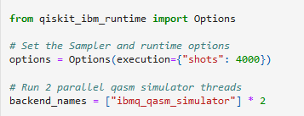
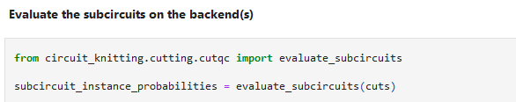

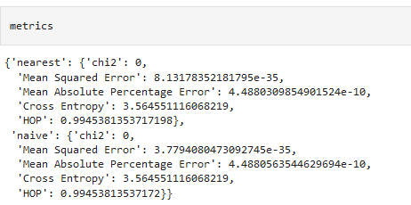
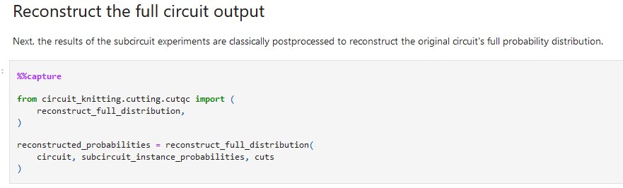
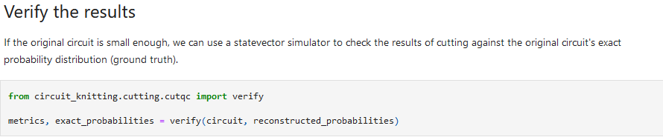

Slide 16
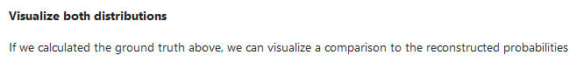
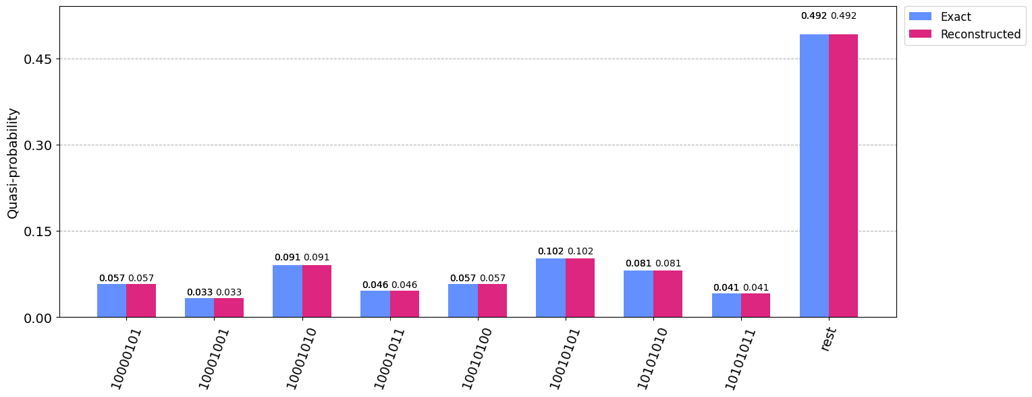

Slide 17

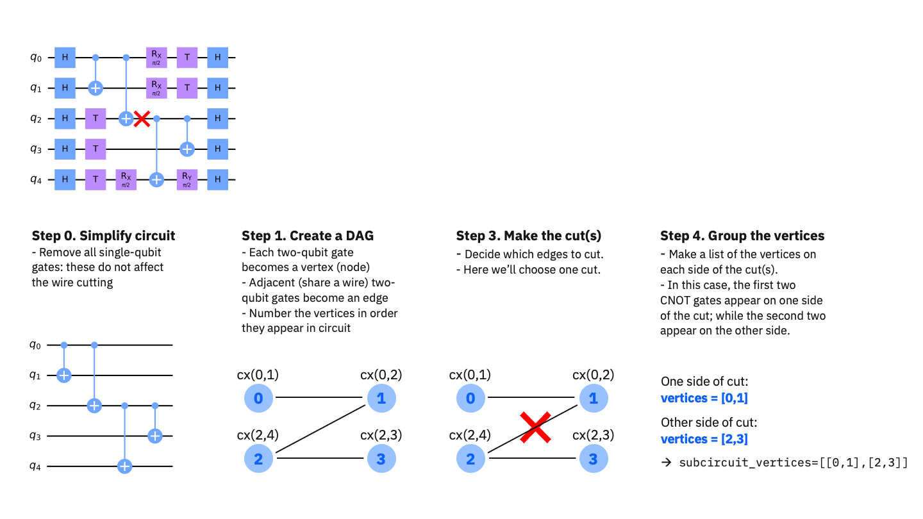

Slide 18
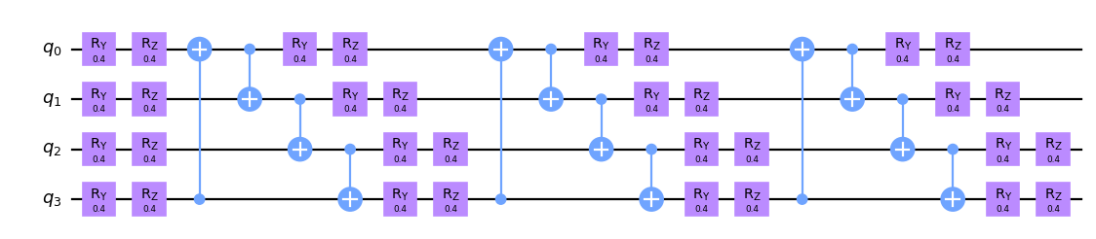
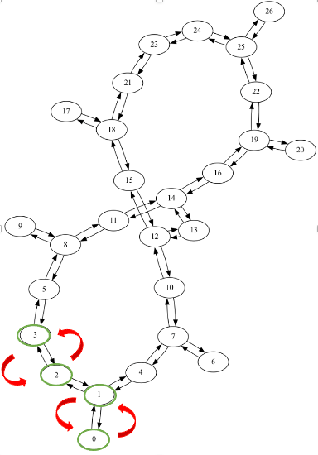
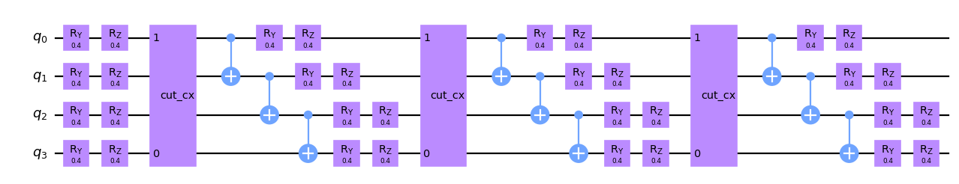

Slide 19
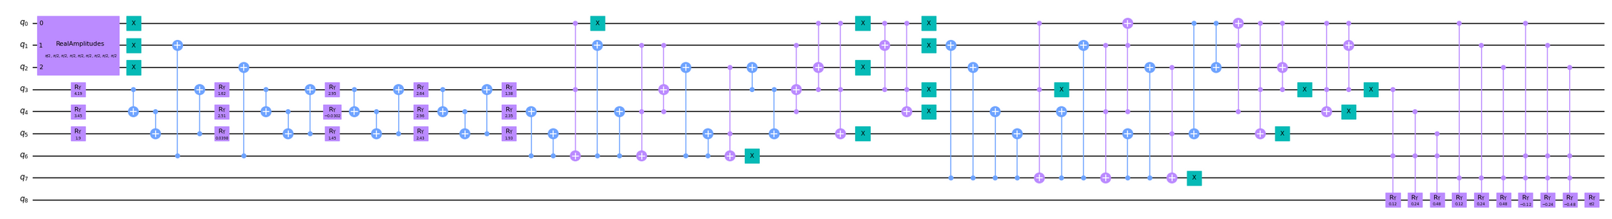
Original Quantum Circuit
Num Qubits = 9 , Depth = 32
Transpile
Num Qubits = 9 , Depth = 384

Slide 20
Controllable Parameters
Circuit : The circuit that you want to cut
The Original Quantum Circuit
Method: Do you want MIP to solve or select the cut manually
select ‘automatic’ for MIP solver
Maximum Subcircuit Width : How big should the subcircuit be?
If the original quantum circuit is `n` qubits, this should be `n-3` at most
Maximum Cuts: How many cuts there should be in the circuit?
Deeper the circuit, more the cuts should be.
Number of Subcircuits : How many subcircuits should be there?
Do at least 3-4 subcircuits.

Slide 21
The Subcircuits
1.
7 qubits, depth = 103
2.
7 qubits, depth = 88
3.
7 qubits, depth = 81
4.
6 qubits, depth = 120

Slide 22
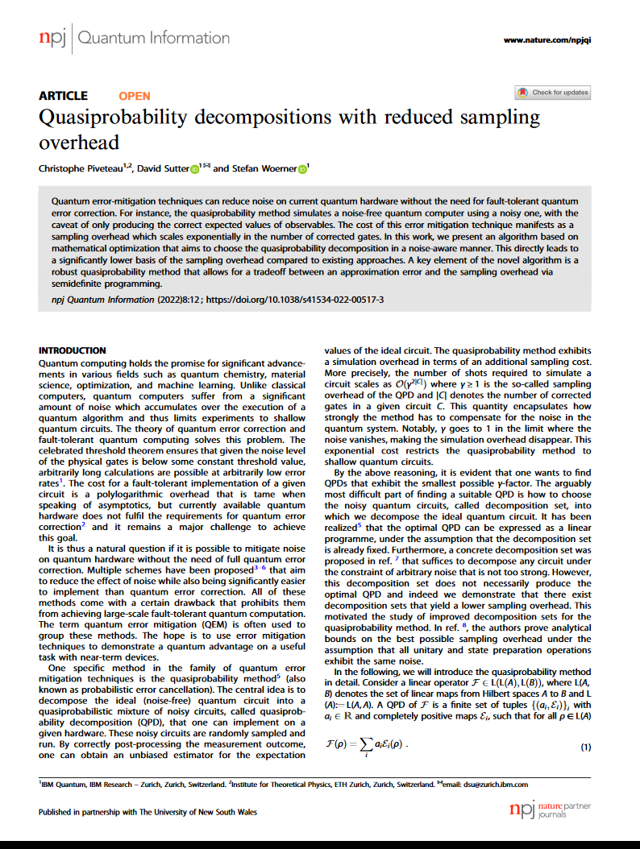
Circuit Knitting
Num Qubits = 9 , Depth = 32
Num Qubits = 9 , Depth = 384

Slide 23
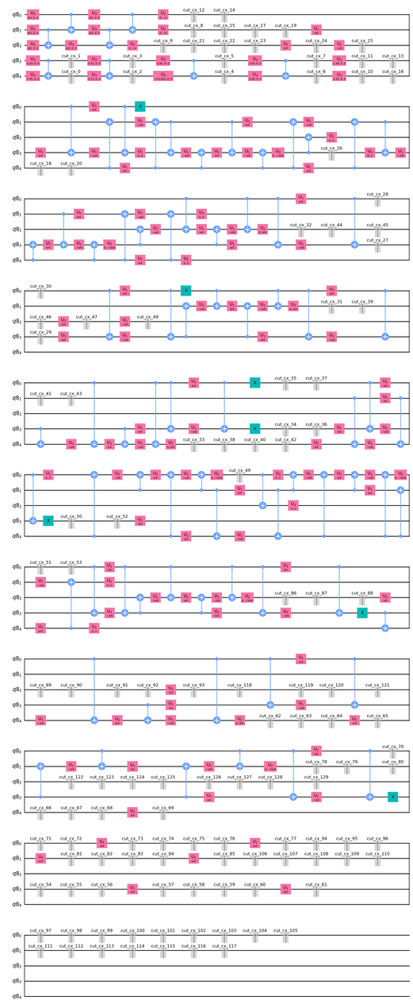
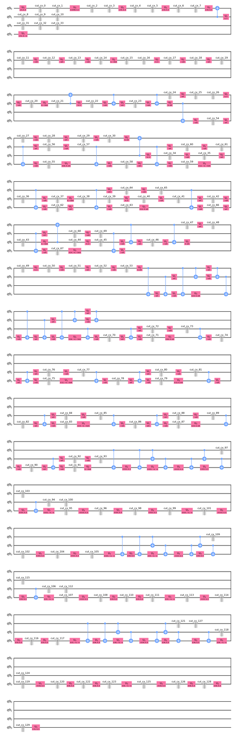
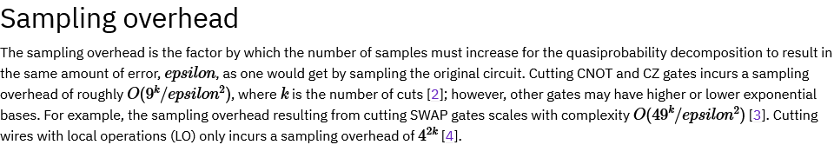
117 Cuts
129 Cuts
Sampling overhead: 1.1259684642548715 * 10^124
5 qubits, depth = 120
4 qubits, depth = 167

